Slide 1

Visualizing Birds of Bardiya National Park Using R
Jagat Narayan Shah
0000-0003-3435-2496

Slide 2

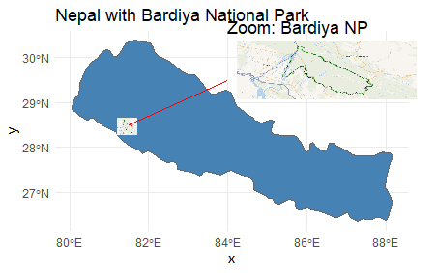
Background Information
513 (57 %) different species of birds
Globally significant habitat for birds

Slide 3
Overview
This tutorial prospectus outlines the diversity and conservation status of bird species in Bardiya National Park.
The research aims to document the park's avian biodiversity, analyze species distribution and abundance, and assess population trends of endangered and critically endangered birds.
Using a descriptive and analytical research design, the study utilized secondary data from published literature, government records, and conservation organizations.
R programming has been employed for spatial mapping, statistical analysis, and effective communication of findings.
The project ultimately seeks to contribute to conservation efforts by providing insights into the status and threats faced by bird species in this ecologically significant region.
Species Diversity
Endangered Species
Documentation & Data
R Programming

Slide 4
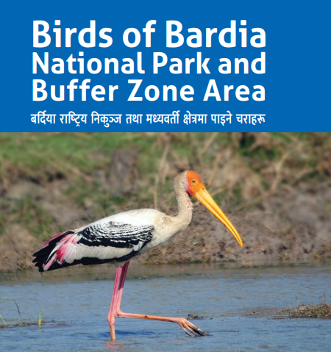
Data

Slide 5
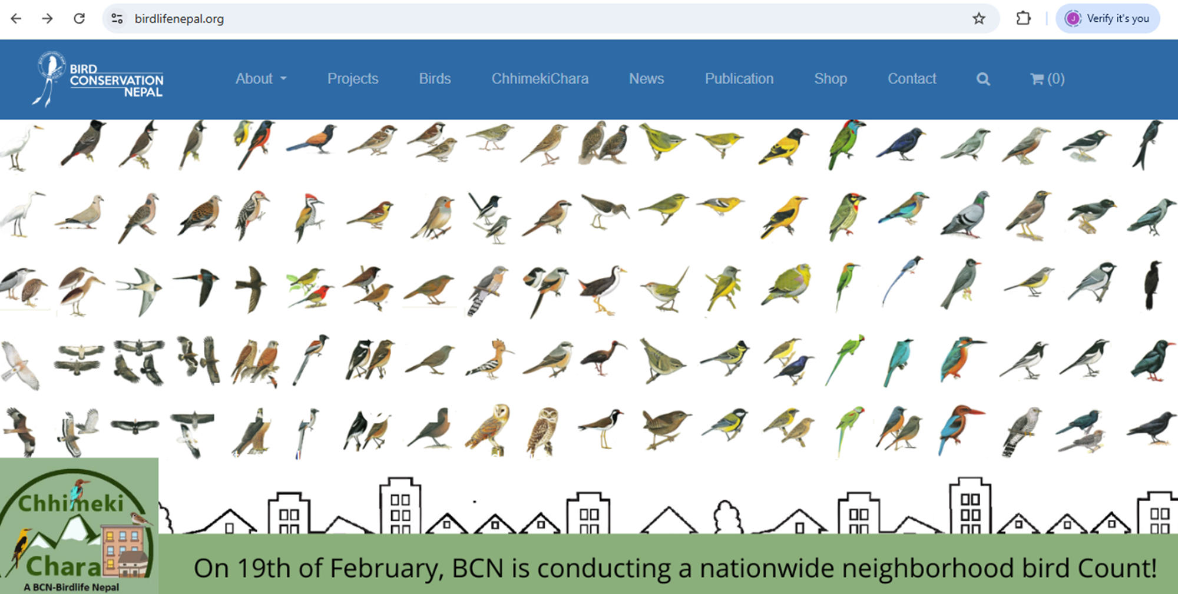

Slide 6
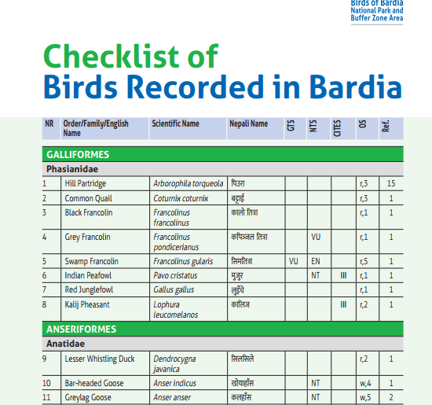
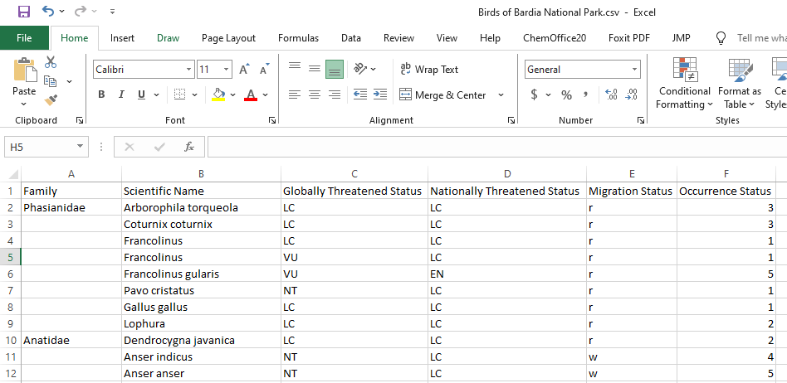

Slide 7
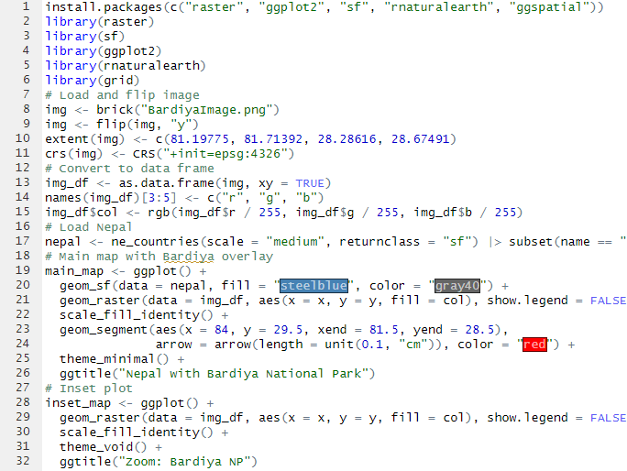
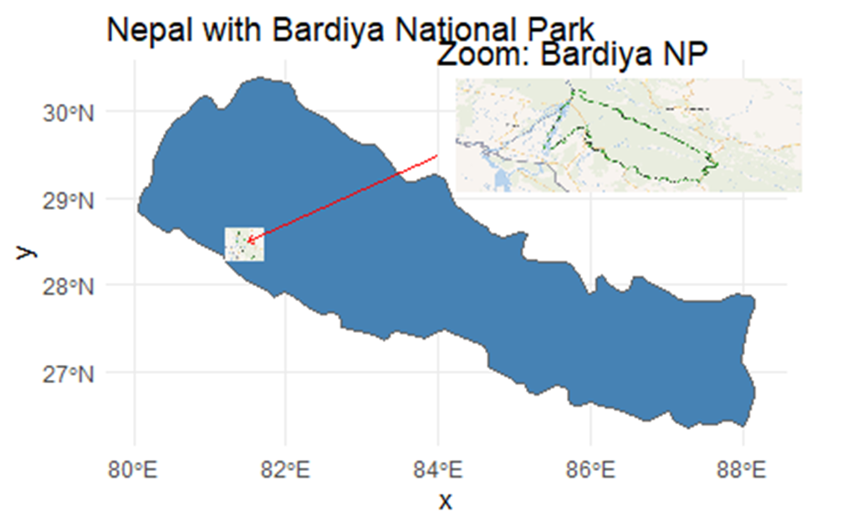
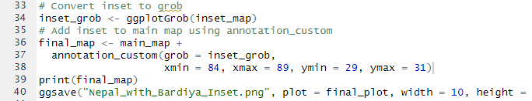

Slide 8
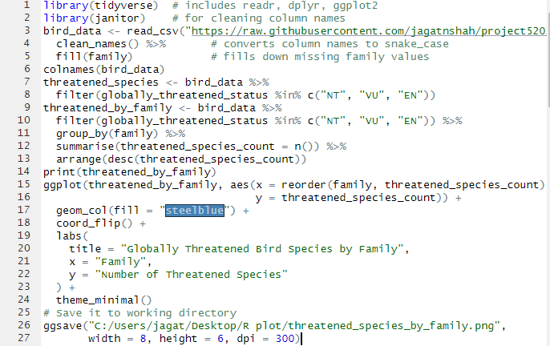

Slide 9
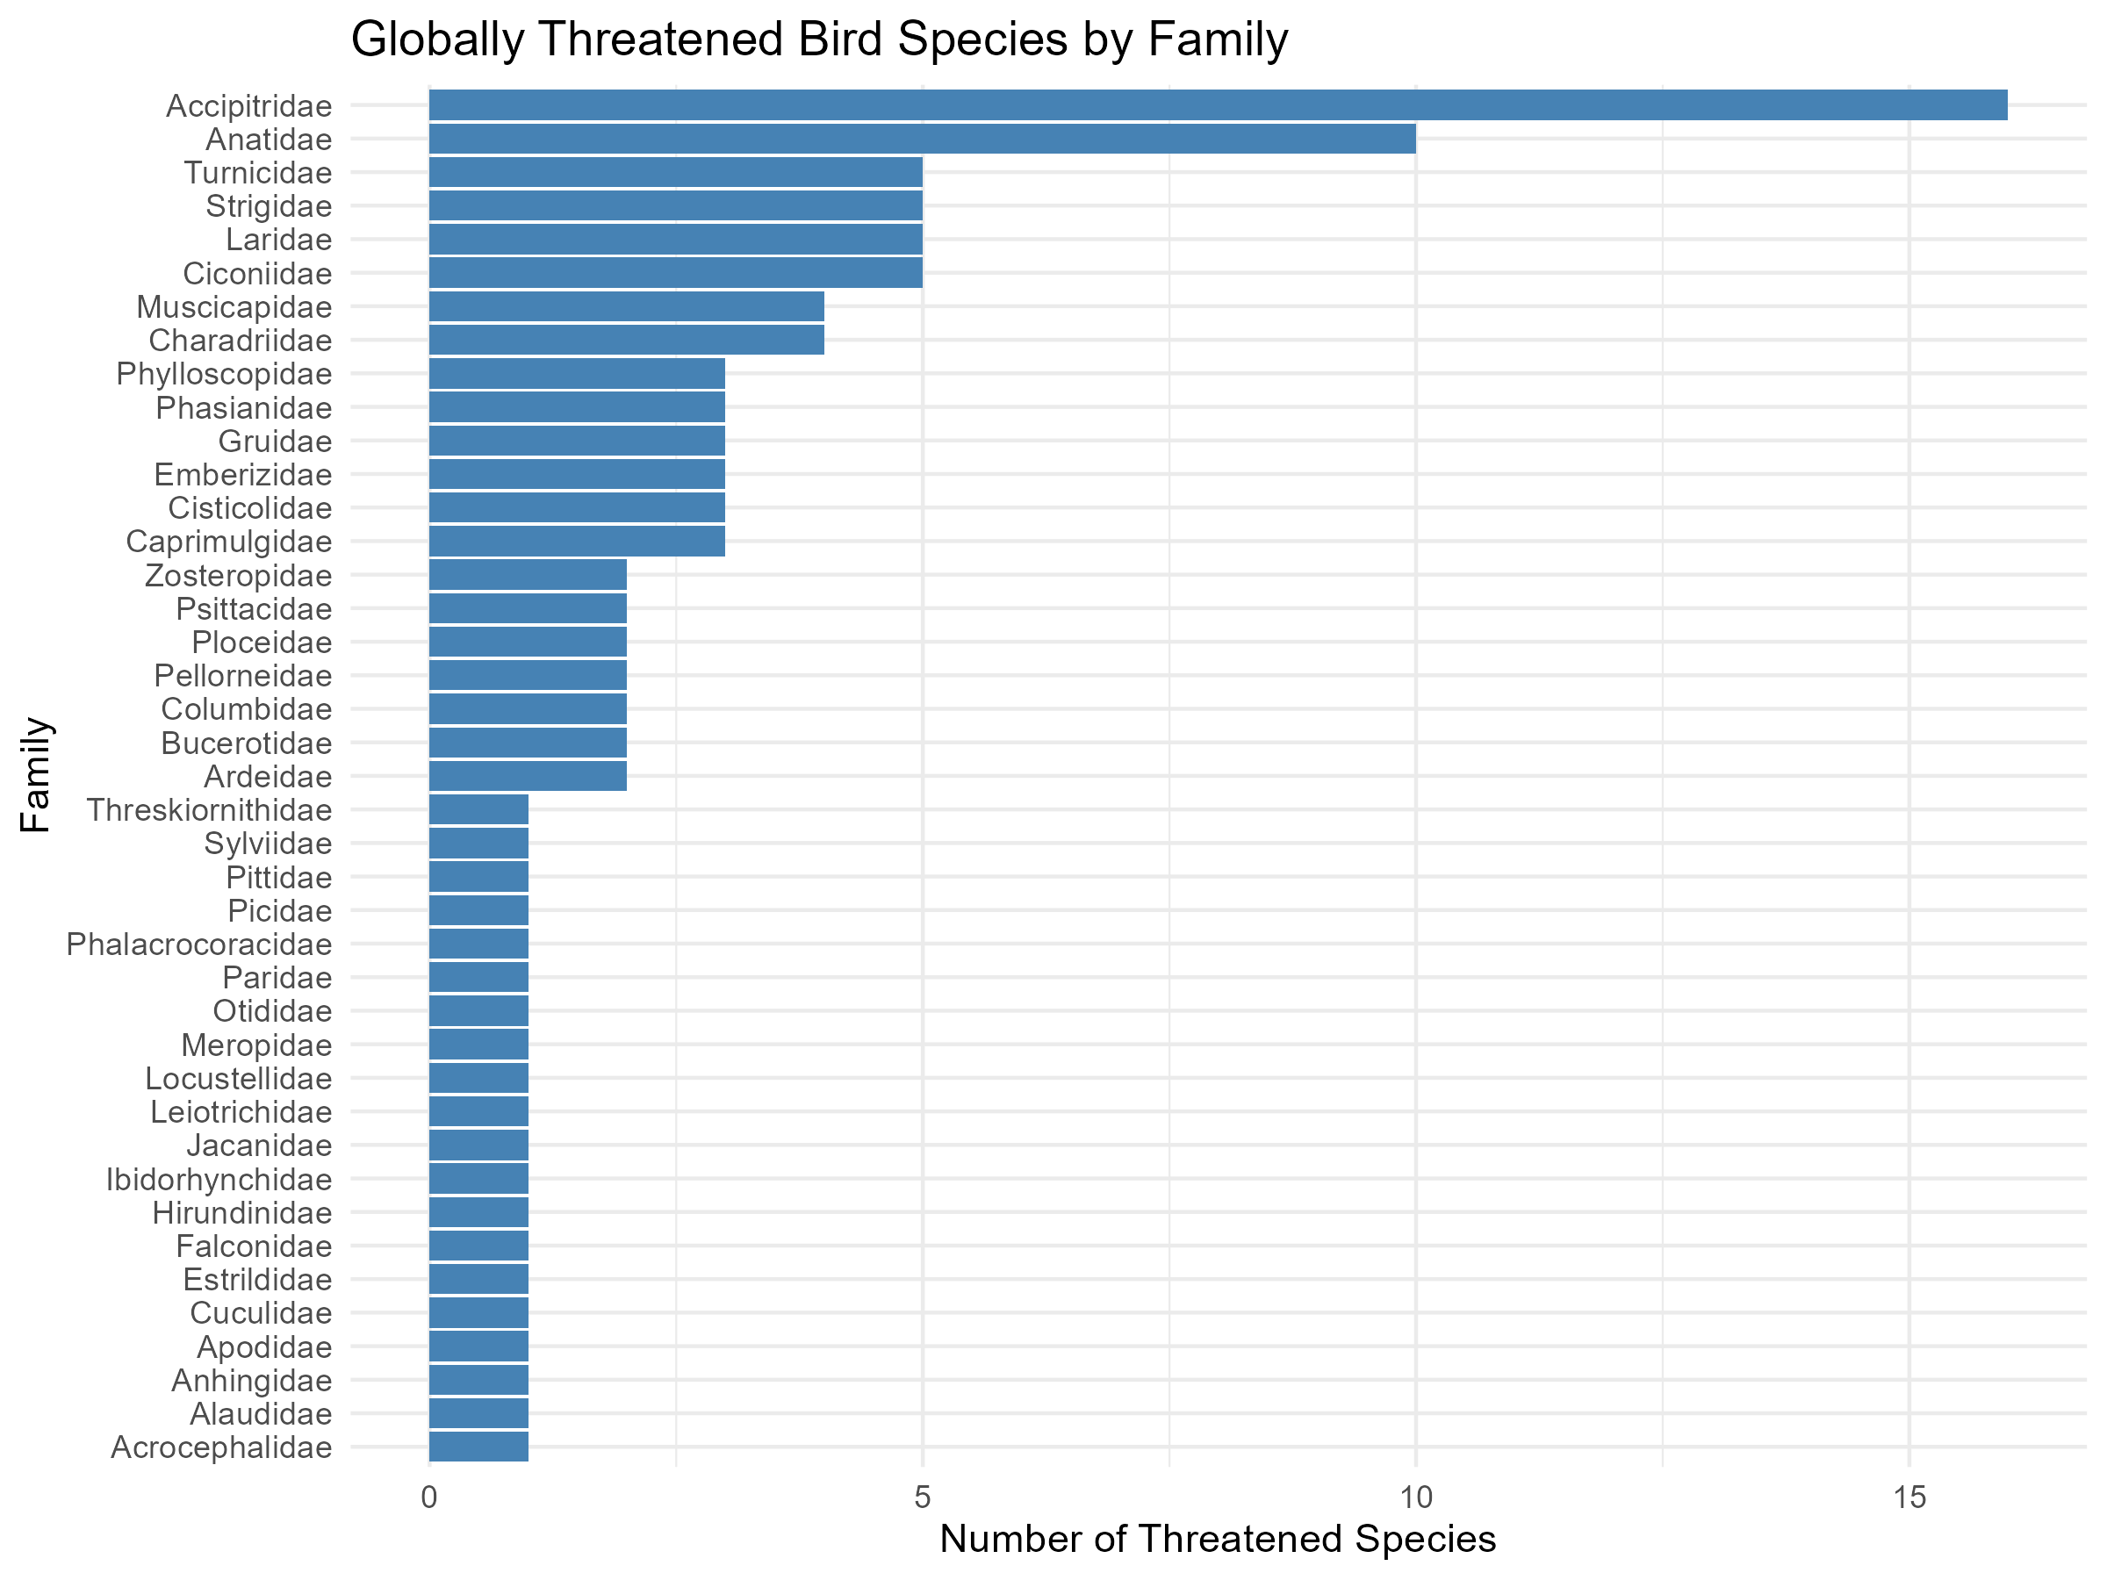

Slide 10
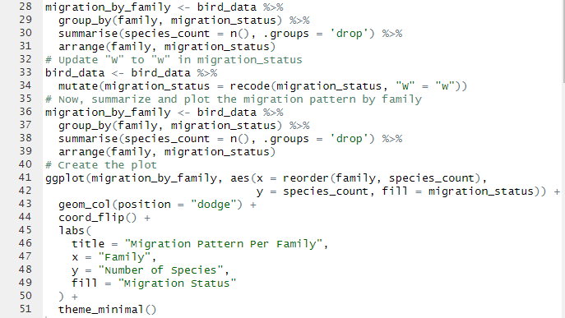

Slide 11
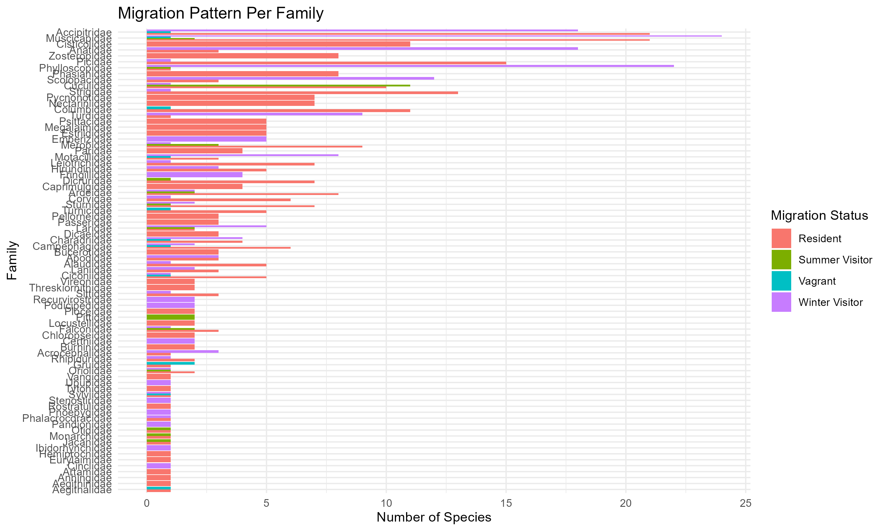

Slide 12
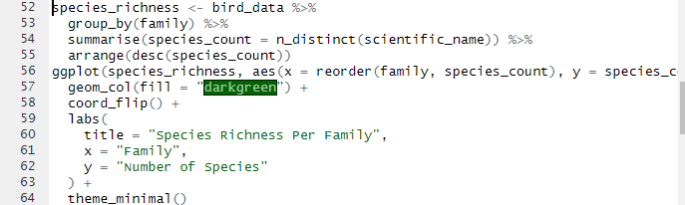

Slide 13
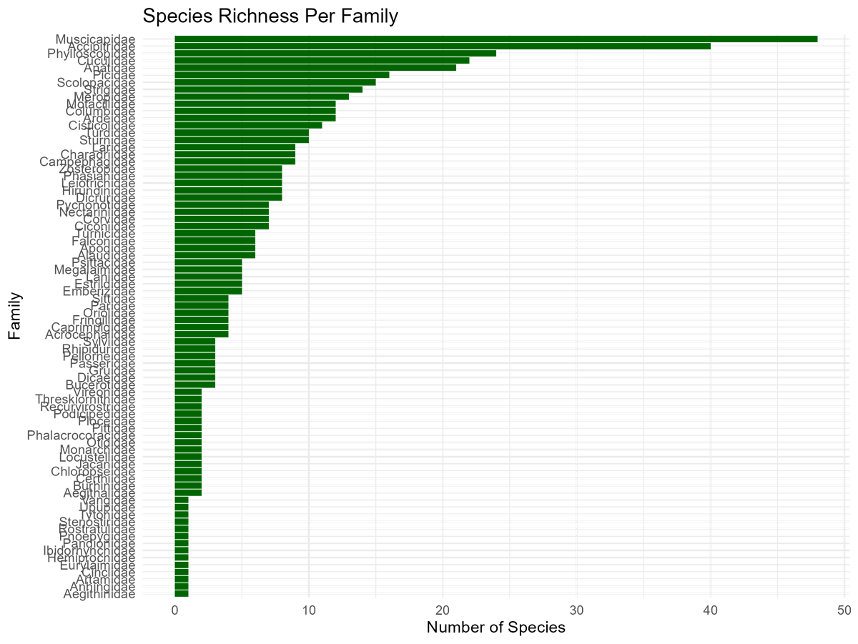

Slide 14
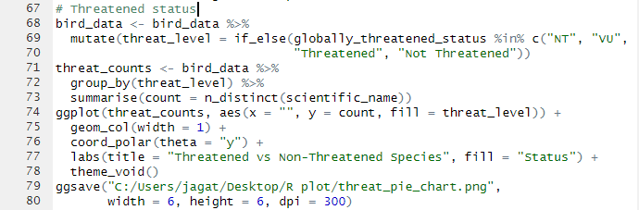
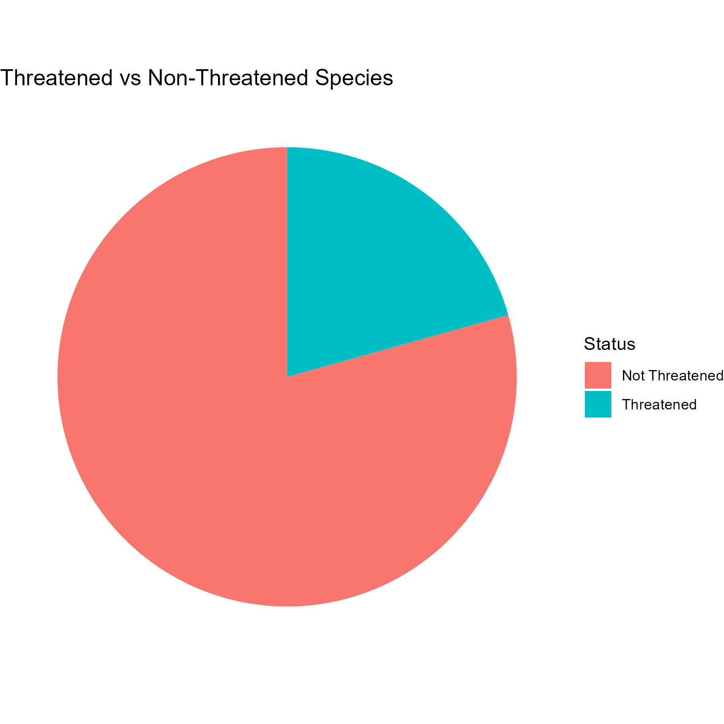

Slide 15
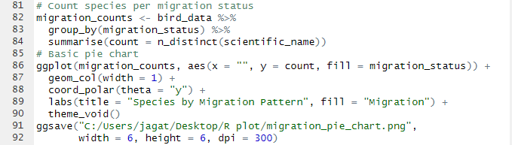
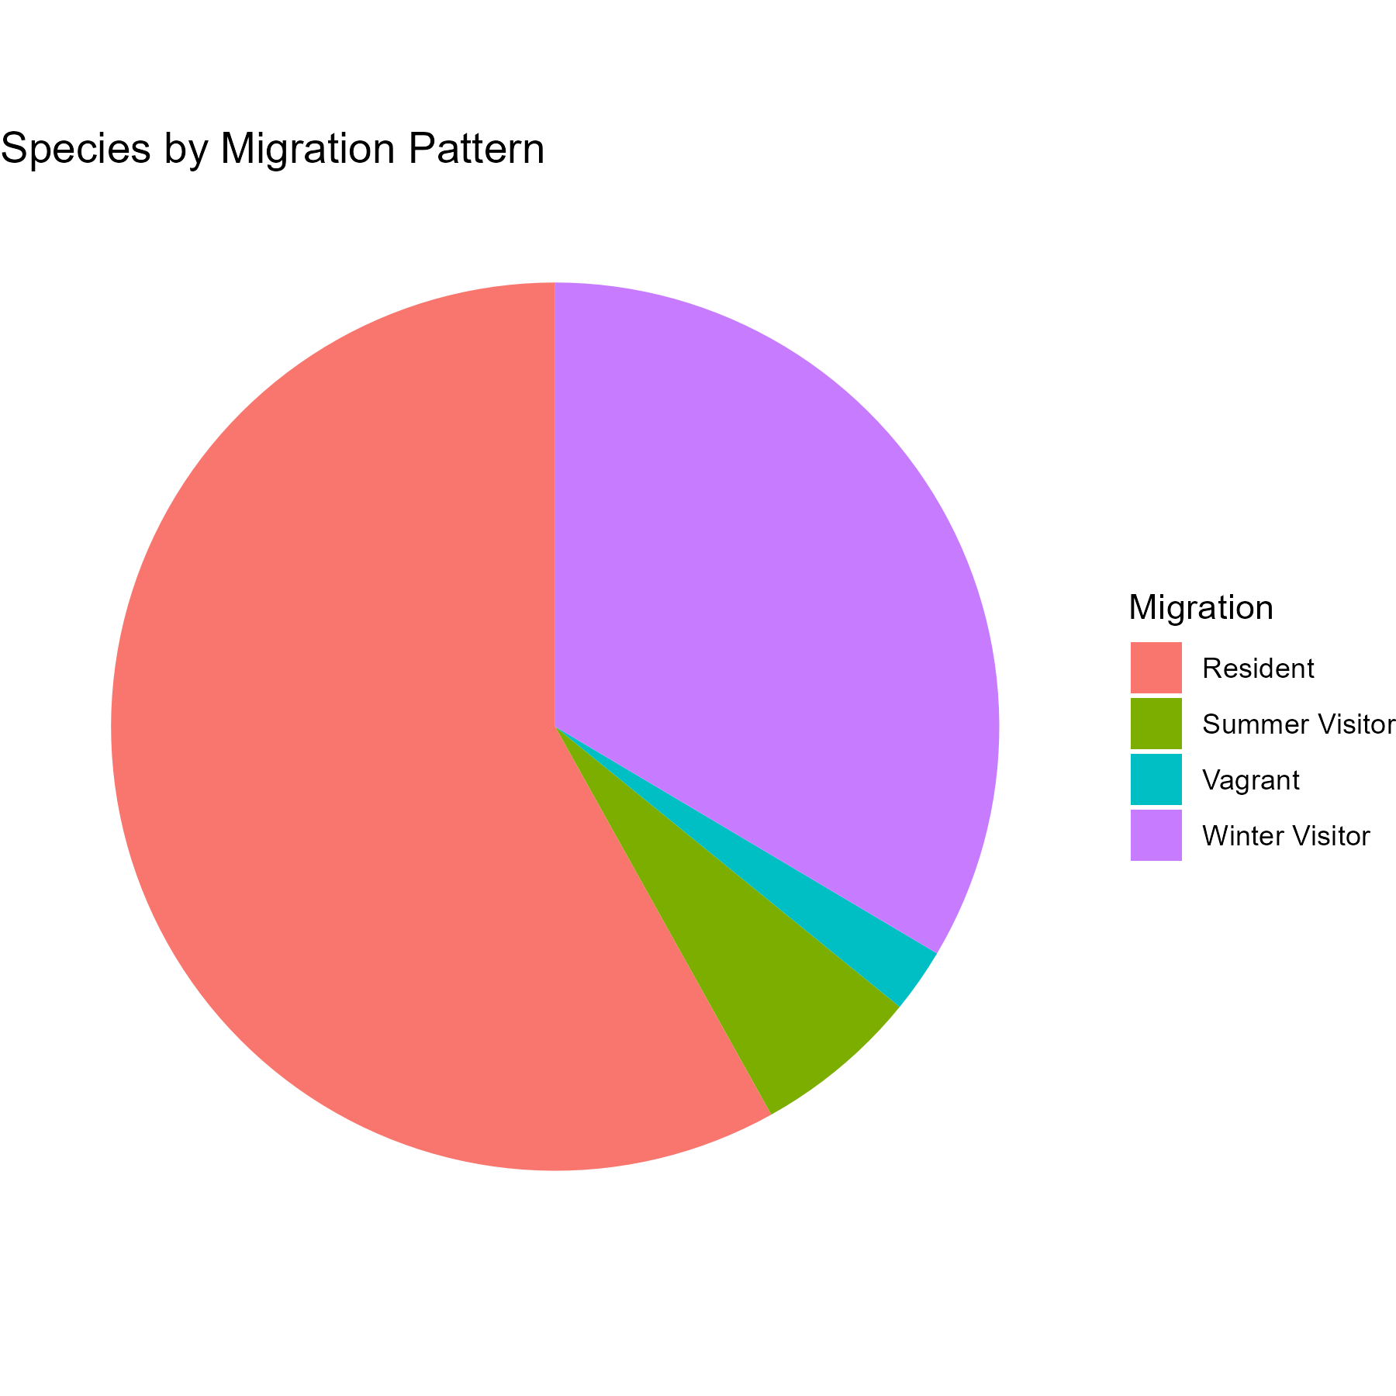

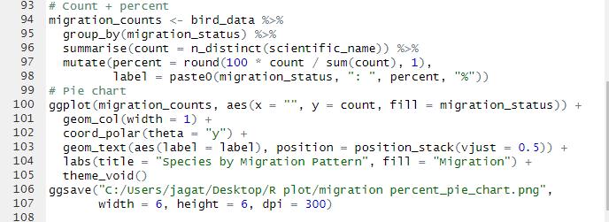

Slide 16
References
BCN and DNPWC (2018). Birds of Nepal. An Official Checklist. Kathmandu, Nepal.
BirdLife International. (2018). Important Bird Areas factsheet: Bardia National Park. Retrieved from http://www.birdlife.org
Birds of Bardia National Park and Buffer Zone Area (2022)
Bird Conservation Nepal

Slide 17
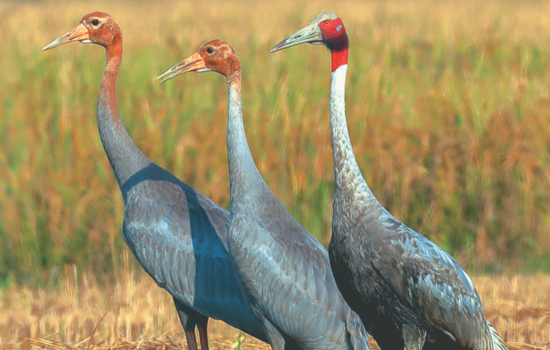
Questions?

